Slide 1
Gravity from Space
With contributions from GETSI-SERC and MetEd

Slide 2
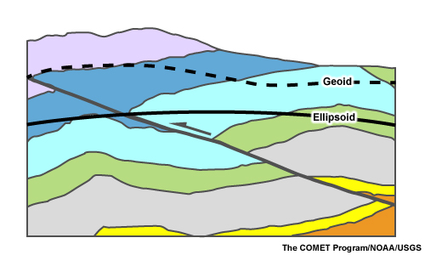
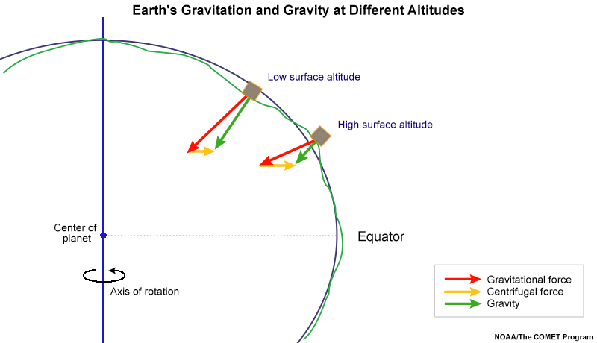
Ellipsoid and Geoid

Slide 3
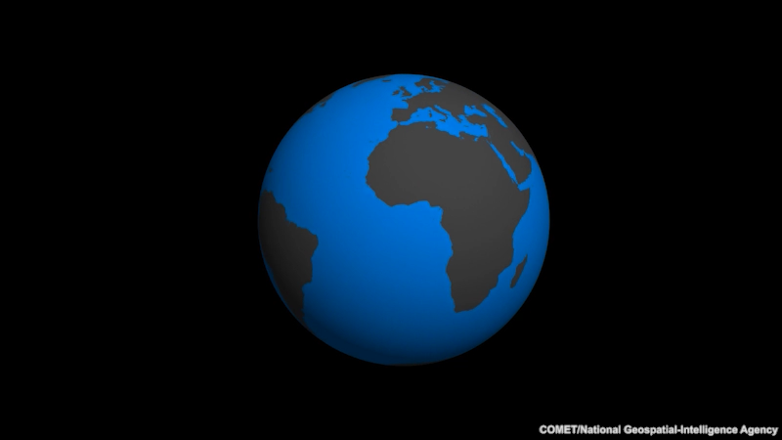
Density variations cause gravity variations = geoid variations

Slide 4
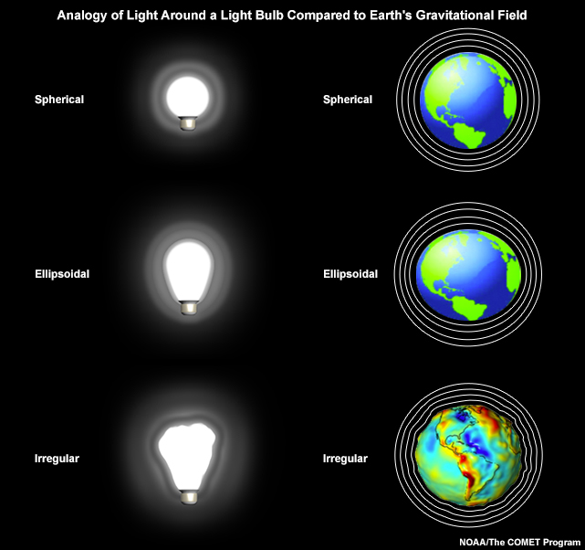
Elevation variations cause gravity variations = geoid variations

Slide 5
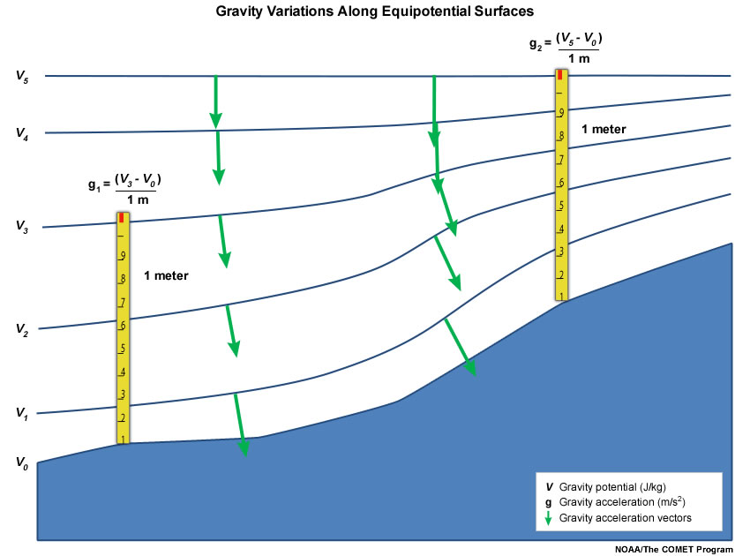
Elevation + density variations cause gravity variations = geoid variations

Slide 6
Elevation + density variations cause gravity variations = geoid variations
Note that while the potential is constant along an equipotential surface, the acceleration due to gravity (g) is not. In fact, gravity varies in both magnitude and direction along the equipotential surface. Recall from section 2a, the light bulb analogy, that equipotential surfaces are neither parallel nor equidistant.

Slide 7
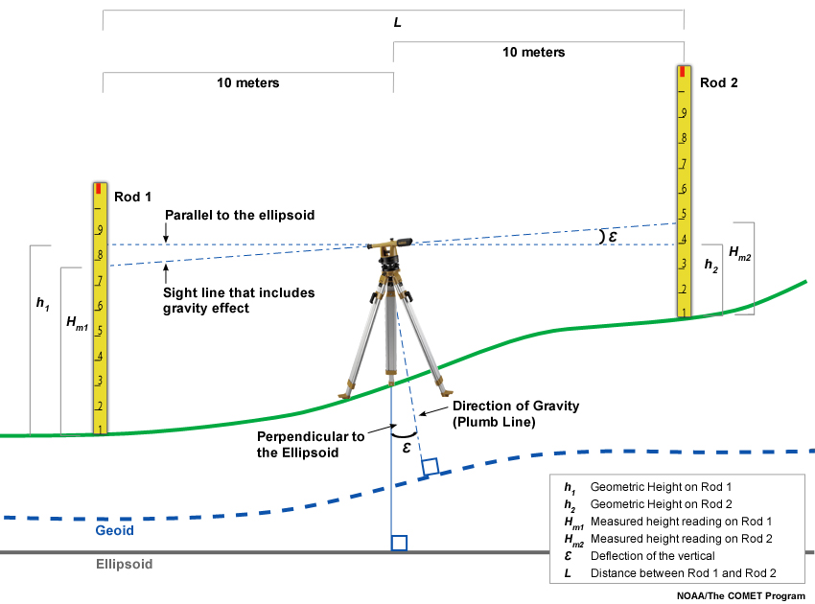
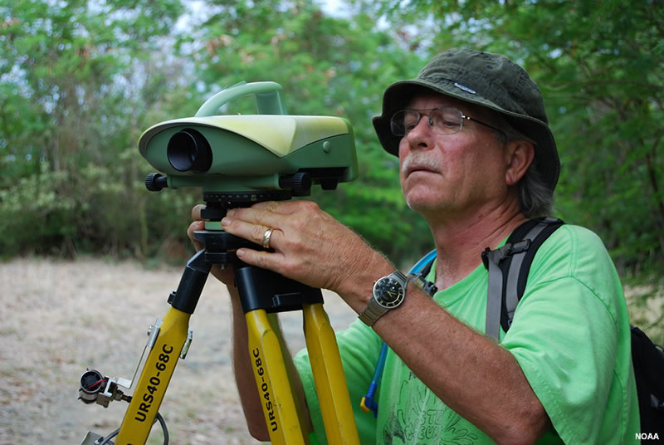
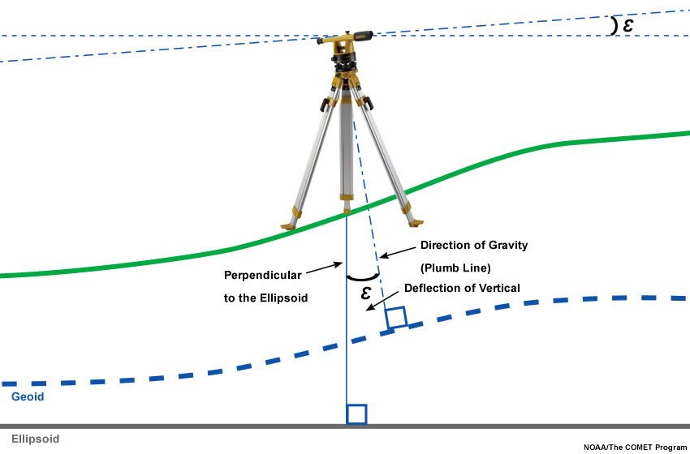
Leveling surveys reference the geoid
In comparison, GPS/GNSS references the ellipsoid

Slide 8
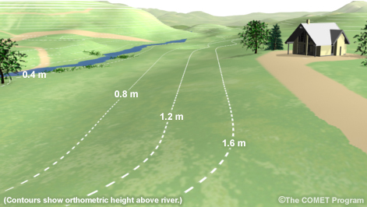
Geoid vs ellipsoid for flooding
Imagine that the owners of the house shown above have used GPS to measure ellipsoidal heights and to map their property. Based on that survey, they believe their road is safe from a 5-foot (1.5-meter) flood. But is it?

Slide 9
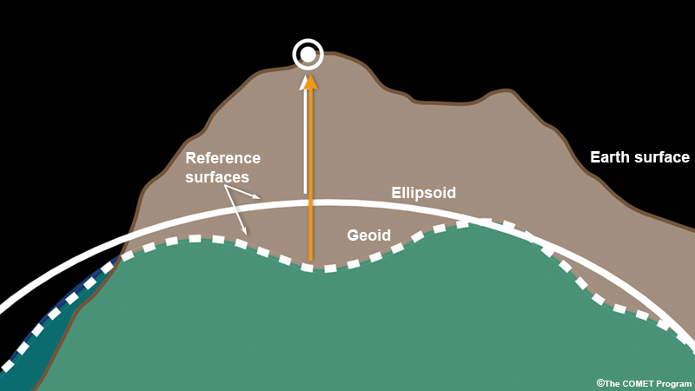
Vertical Datums

Slide 10
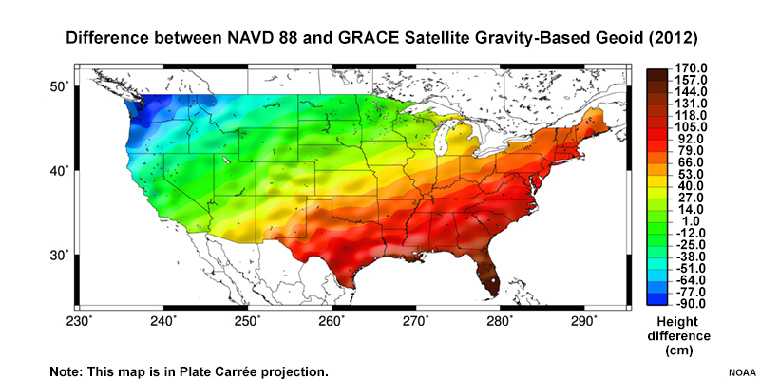
Geoid vs Ellipsoid in USA

Slide 11
How do elevation, density variations affect gravity?
Gravity – density exercise
Data that goes into the gravity datum
Time-dependence

Slide 12
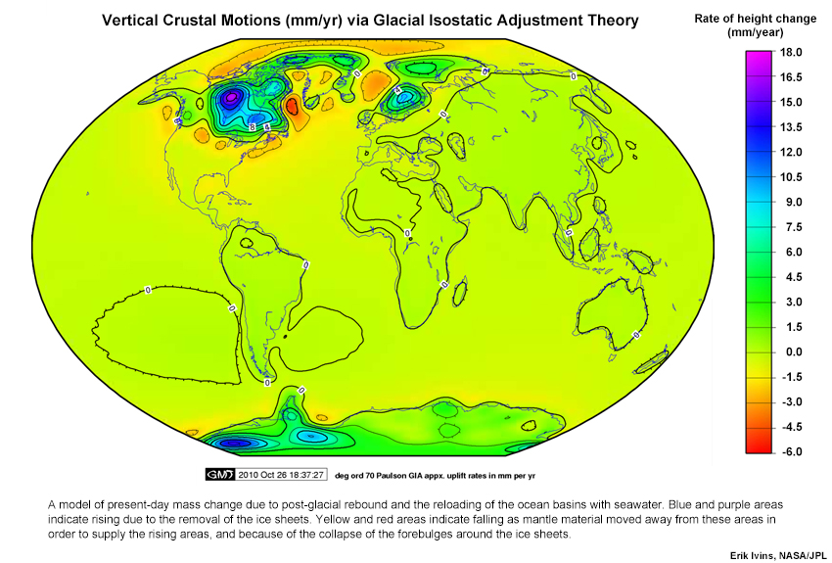
Time changes in the geoid / gravity field

Slide 13
Time changes in the geoid / gravity field
To maintain an accurate gravity-based datum, changes must be monitored using the gravity measurement techniques discussed above. These new measurements are then used to update the model so an accurate datum is available everywhere into the future.

Slide 14
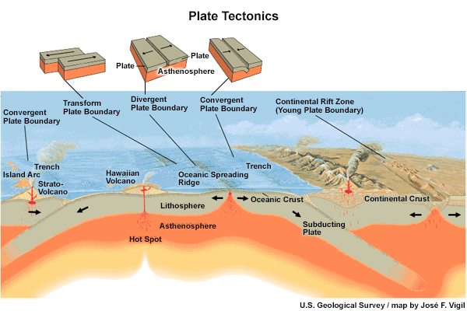
Mass movements in Earth systems

Slide 15
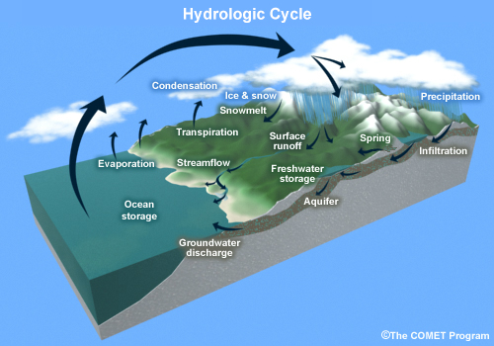
Mass movements in Earth systems

Slide 16
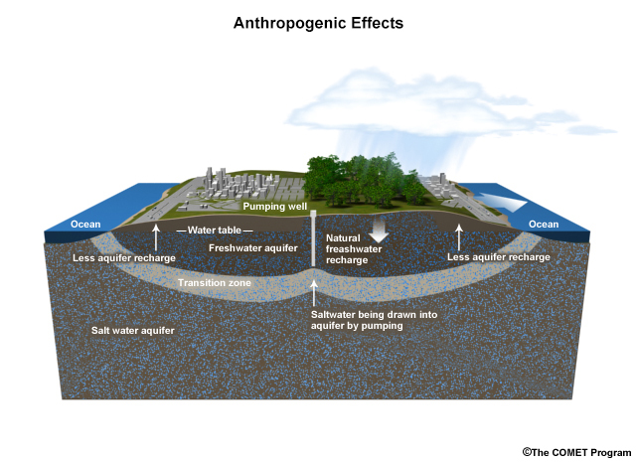
Mass movements in Earth systems

Slide 17
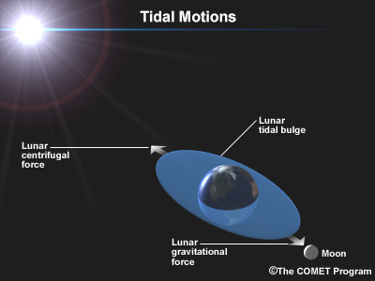
Mass movements in Earth systems

Slide 18
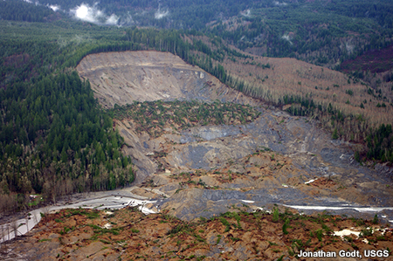
Mass movements in Earth systems

Slide 19
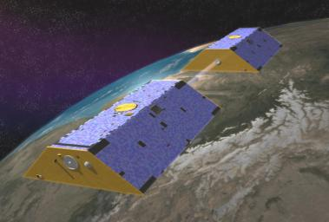
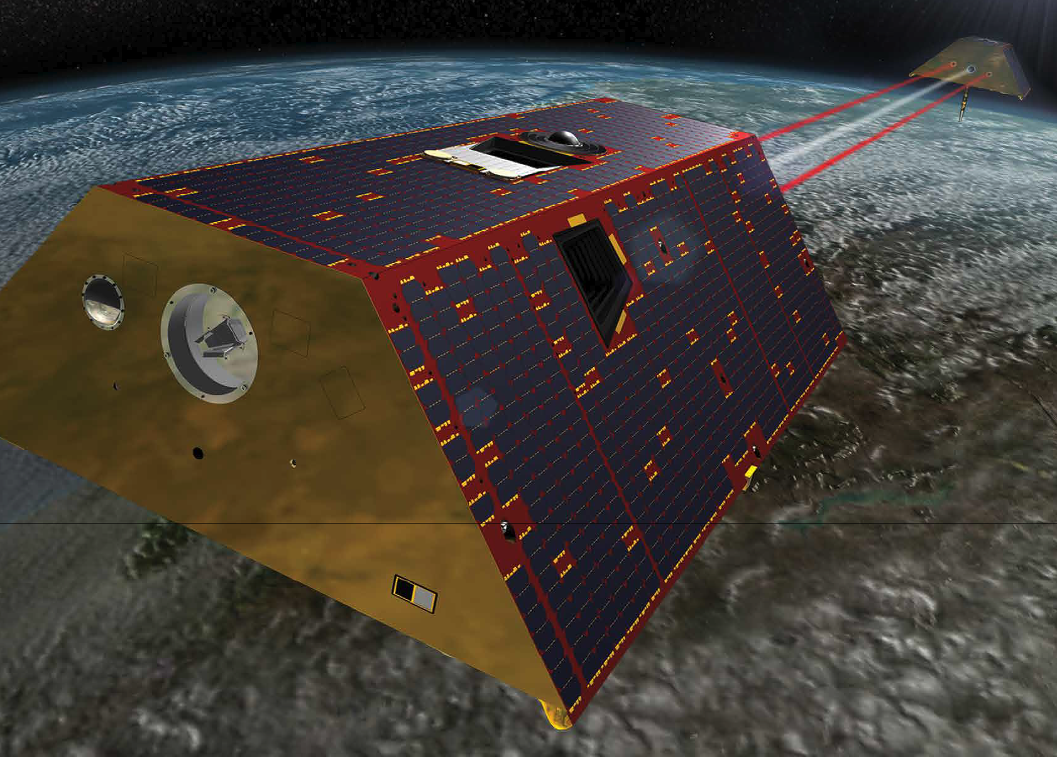
GRACE Missions: Gravity Recovery and Climate Experiment
Original GRACE satellites 2002-17
GRACE Follow-on launched 2018
Notes:
http://photojournal.jpl.nasa.gov/jpegMod/PIA04235_modest.jpg (public domain)
https://gracefo.jpl.nasa.gov/resources/71/grace-fo-mission-brochure/

Slide 20
GRACE Missions: Gravity Recovery and Climate Experiment
https://youtu.be/Vus2XM-3q4A
https://youtu.be/s93i7m82h54
Original GRACE satellites 2002-17
GRACE Follow-on launched 2018
Notes:
http://photojournal.jpl.nasa.gov/jpegMod/PIA04235_modest.jpg (public domain)
https://gracefo.jpl.nasa.gov/resources/71/grace-fo-mission-brochure/

Slide 21
GRACE Mission: Gravity Recovery and Climate Experiment
“GRACE consists of two identical spacecraft that fly about 220 kilometers apart in a polar orbit 500 kilometers (310 miles) above Earth. GRACE maps Earth's gravity field by making accurate measurements of the distance between the two satellites, using GPS and a microwave ranging system. It is providing scientists from all over the world with an efficient and cost-effective way to map Earth's gravity field with unprecedented accuracy.
The gravity variations studied by GRACE include: changes due to surface and deep currents in the ocean; runoff and ground water storage on land masses; exchanges between ice sheets or glaciers and the ocean;……”
Notes:
From: http://www.nasa.gov/mission_pages/Grace/overview/index.html#.VWcUAmRViko

Slide 22
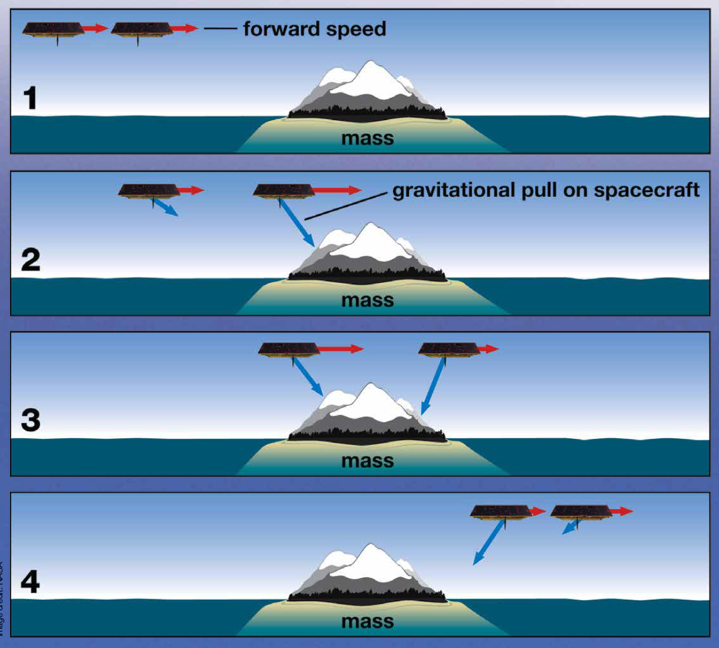
GRACE satellites sensing gravity changes
Notes:
https://gracefo.jpl.nasa.gov/resources/71/grace-fo-mission-brochure/
The distance between the satellites provides a way to measure the changing gravity field.

Slide 23
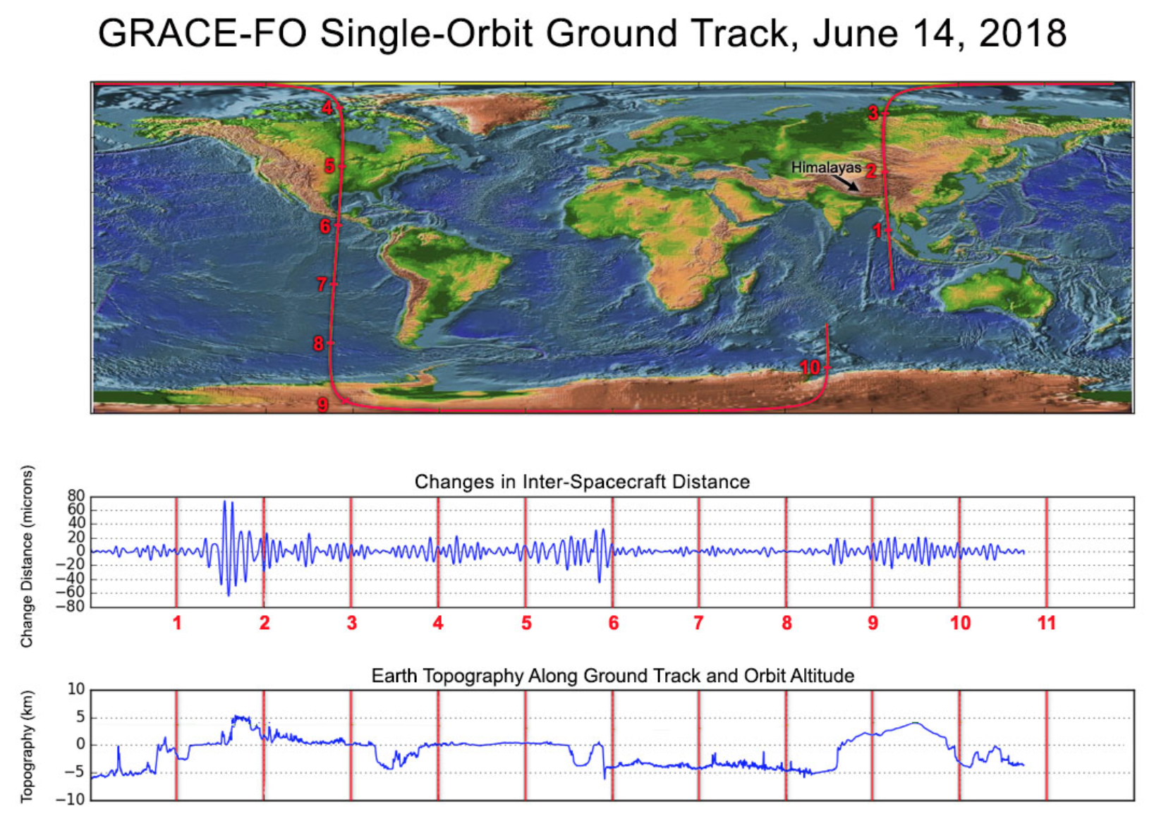
Example of distance & topography relationship
Notes:
OPTIONAL
https://gracefo.jpl.nasa.gov/news/138/first-laser-light-for-grace-follow-on/
“Along the satellites' ground track (top), the inter-spacecraft distance between them changes as the mass distribution underneath (i.e., from mountains, etc.) varies. The small changes measured by the Laser Ranging Interferometer (middle) agree well with topographic features along the orbit (bottom).”
This may be more information that you wish to get into with students but in reality there is a somewhat complex relationship between the distance between the satellites and the underlying topography/gravity with oscillations that need to be converted into a gravity value.

Slide 24
GRACE data characteristics:
2-6 month latency
Monthly data (some months missing)
Coarse spatial resolution (~100’s km)
GRACE original mission ran 2002-2017 (5-year expected duration was far outlived although by late 2016 GRACE was under modified operations to prolong battery life)
GRACE Follow-on mission launched May 2018, initially had some issues with onboard equipment, but data flow was expected in 2019.

Slide 25
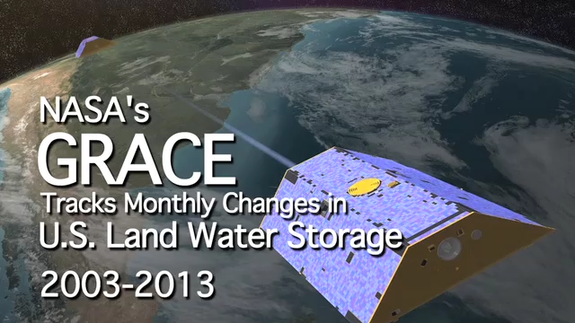
GRACE measures gravity changes in time

Slide 26
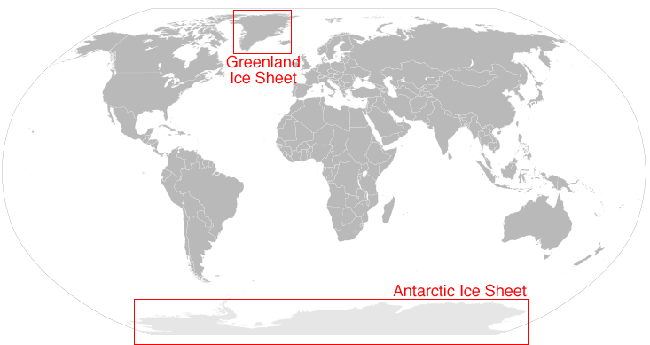
Location of Greenland and Antarctic Ice Sheets
Notes:
Map from: https://nsidc.org/sites/nsidc.org/files/images//map_icesheet.png (public domain)
https://nsidc.org/cryosphere/quickfacts/icesheets.html
Ice sheet facts
An ice sheet is a mass of glacial land ice extending more than 50,000 square kilometers (20,000 square miles).
Ice sheets today include Antarctica and Greenland, but during the last ice age ice sheets also covered much of northern North America and Scandinavia.
Antarctica and Greenland contain more than 99% of freshwater ice on earth.
Antarctica ice sheet extends 14 million square kilometers (5.4 million square miles) and is roughly the size of the United States and Mexico combined.
The Greenland ice sheet extends 1.7 million square kilometers (656,000 square miles), roughly three times as large as Texas.

Slide 27
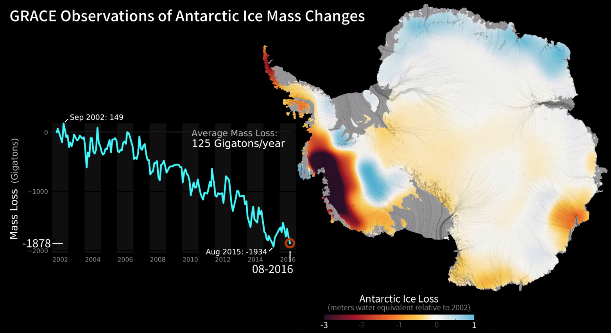
Animation of the change available from https://svs.gsfc.nasa.gov/30880

Slide 28
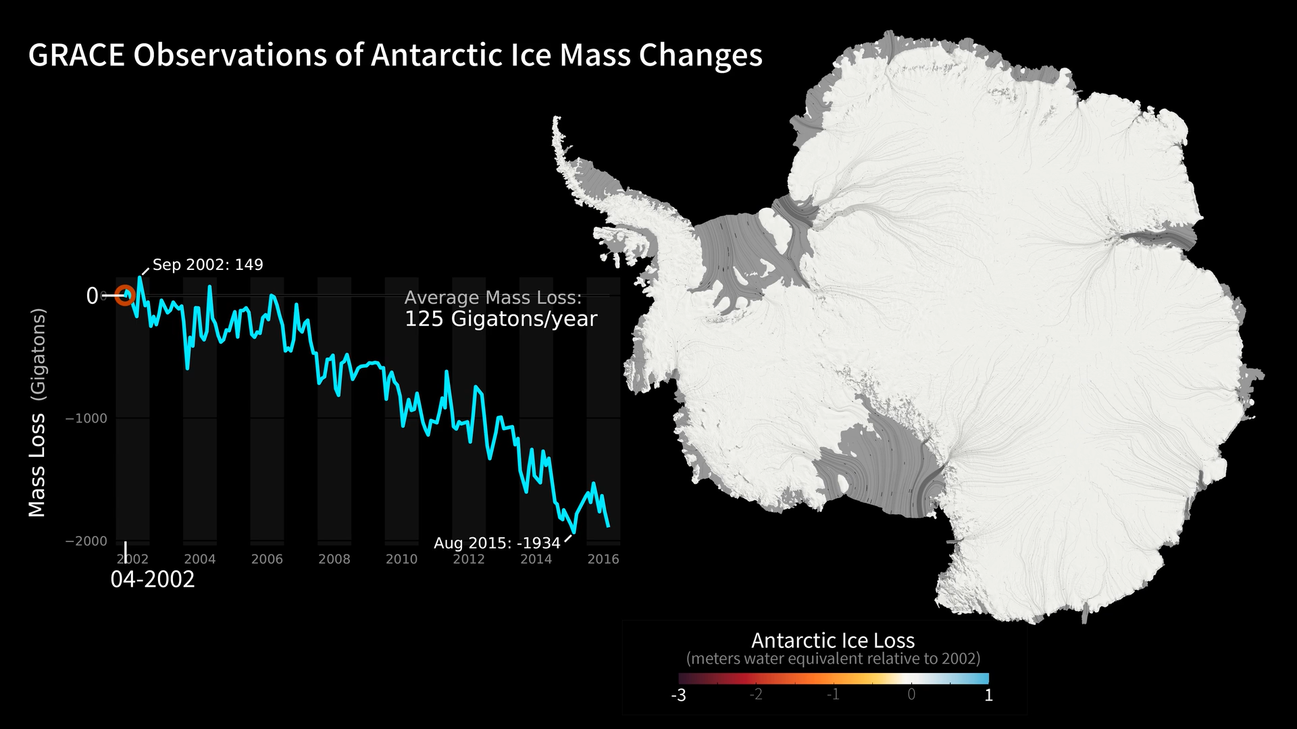
Mass change in Antarctica over time

Slide 29
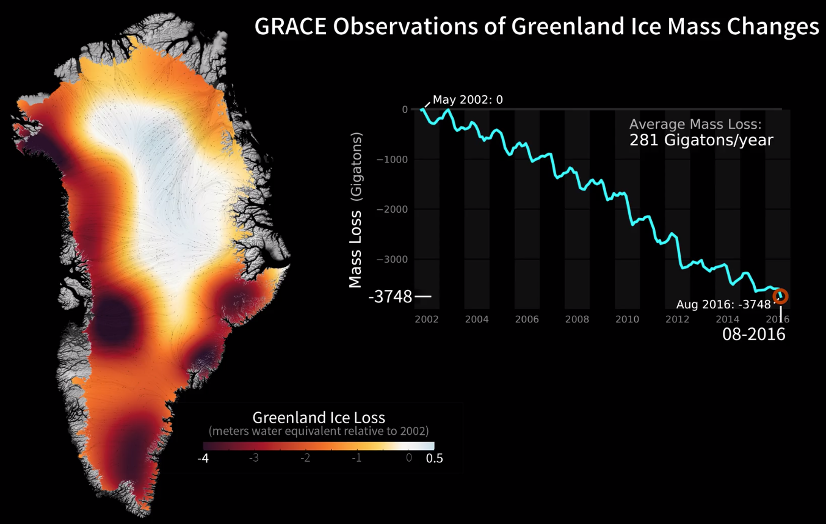
Animation of the change available from https://svs.gsfc.nasa.gov/30879
Notes:
Note: this color scale runs from -4 to 0.5 meters instead of -3 to 1 meters in Antarctica

Slide 30
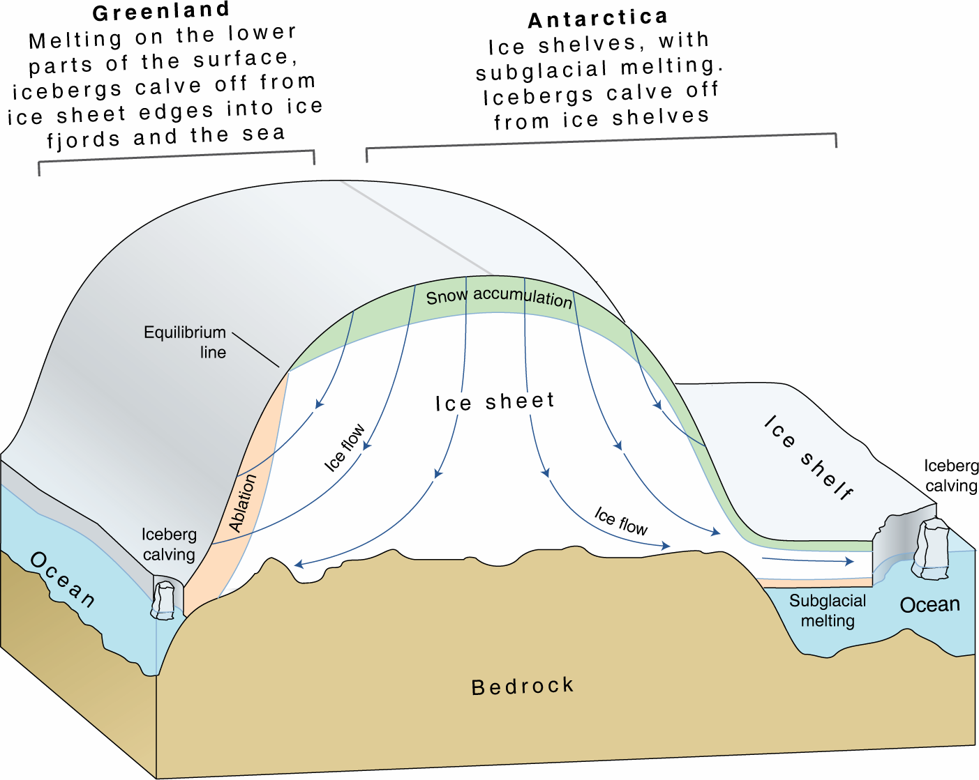
Ice Sheet Components
Very vertically exaggerated
Notes:
This cartoon shows numerous important components of ice sheets, including the differences between Antarctica and Greenland.
Notice that Greenland and Antarctica both gain mass through snow accumulation, whereas the processes dominating mass loss are different. Both ice sheets undergo iceberg calving, whereas surface melting of the lower elevation regions is a major source of ice mass loss only in Greenland. Antarctic ice flow drains into many ice shelves that surround the periphery of West and East Antarctica. Ice mass is lost from the ice shelves due to subglacial melting and iceberg calving. Greenland has few ice shelves.
https://lima.nasa.gov/img/UNEP_icesheetcartoon.png (public domain)
https://lima.nasa.gov/antarctica/

Slide 31
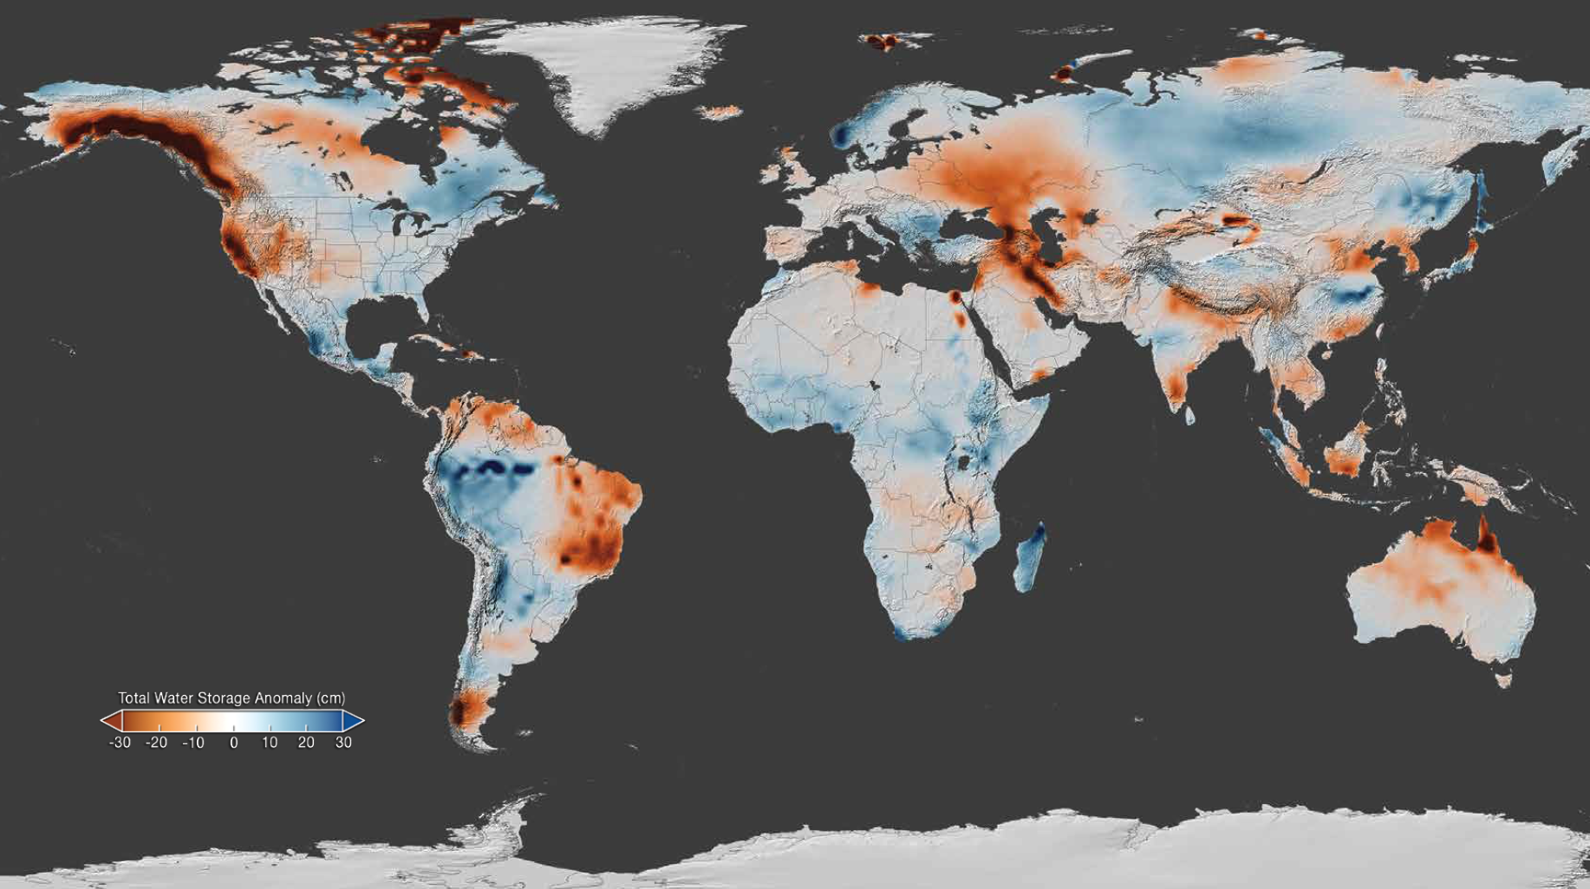
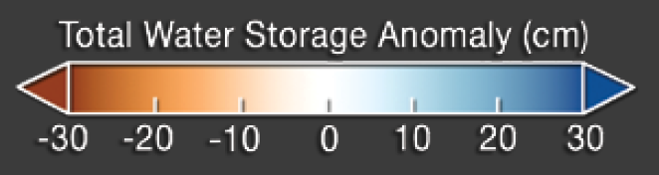
GRACE April 2015 anomaly from 2002-2015 average
Notes:
https://gracefo.jpl.nasa.gov/resources/71/grace-fo-mission-brochure/
The gravity variations measured by GRACE can be used to determine water storage on land. By comparing current data to an average over time, scientists can generate an anomaly map to see where terrestrial water storage has decreased or increased. This map, created using GRACE data, shows the global terrestrial water storage anomaly in April 2015, relative to the 2002-2015 mean. Rust colored areas show areas where water has decreased, and areas in blue are where water levels have increased. Note the significant decreases in water storage across most of California are related to groundwater, while decreases along the Alaska coastline are due to glacier melt.

Slide 32
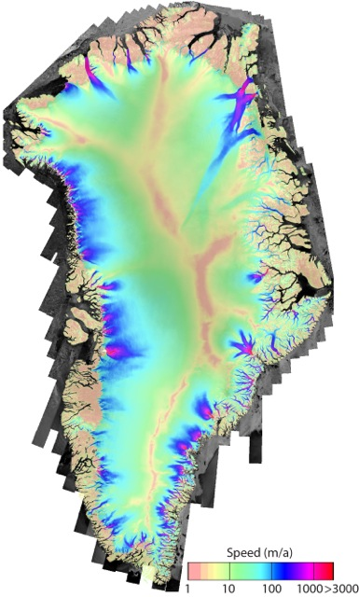
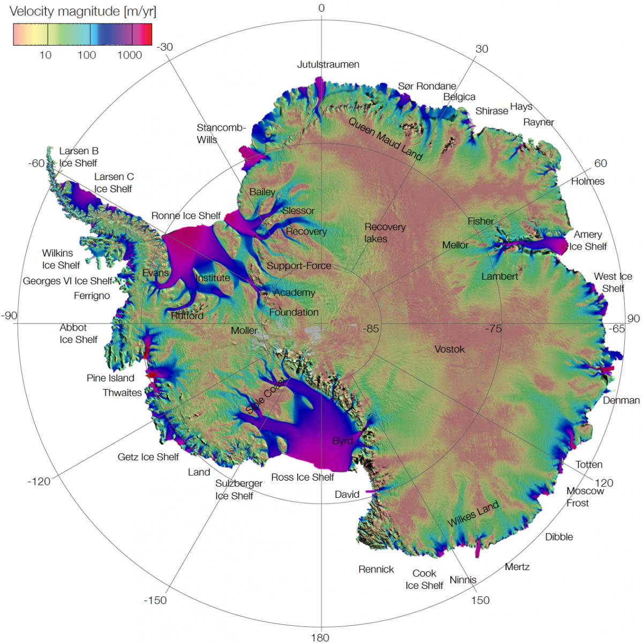
Interferometric Synthetic Aperture Radar (InSAR) Images of Antarctica and Greenland
Notes:
Note: these images are included in the Unit 3 Student Exercise, which includes questions that require students to interpret these maps. Instructors will need to decide if they want to discuss these images in class, or allow students to conduct interpretation of these individually. These maps demonstrate that ice sheet ice velocity is highly variable, and that there are certain regions of the ice sheets referred to as ice streams that transfer ice from the interior of the ice sheets to the ocean. Further information on ice streams is available at: http://www.antarcticglaciers.org/modern-glaciers/types-of-glacier-2/ice-streams/
Rignot, E., J. Mouginot, and B. Scheuchl. 2011. Ice Flow of the Antarctic Ice Sheet, Science. 333. 1427-1430. https://doi.org/10.1126/science.1208336
Mouginot, J., B. Scheuchl, and E. Rignot. 2012. Mapping of Ice Motion in Antarctica Using Synthetic-Aperture Radar Data, Remote Sensing. 4. 2753-2767. https://doi.org/10.3390/rs4092753
https://nsidc.org/sites/nsidc.org/files/images/data/measures/0484v2/SampleImage.png (public domain)
https://nsidc.org/data/nsidc-0484
References for above Images and related videos
http://nsidc.org/data/NSIDC-0670#
http://nsidc.org/data/measures
https://www.youtube.com/watch?v=GDXq8Oa5d5Q
https://www.jpl.nasa.gov/video/details.php?id=1015

Slide 33
Aside – groundwater storage change from GRACE data

Slide 34
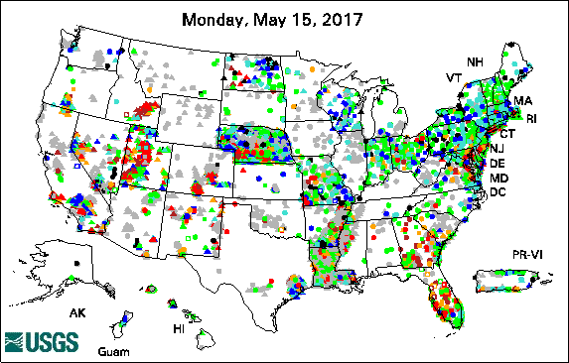
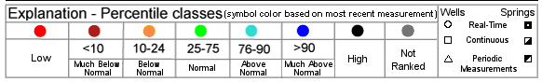
USGS Groundwater Wells
https://water.usgs.gov/ogw/
Notes:
The USGS monitors over 1500 groundwater wells in real time. Archived data is available for over 2000 other wells that have been discontinued.
In the students exercise in this unit, students will look at well data in SE Wyoming part of the High Great Plains Aquifer to see seasonal and decadal changes in water level.
Looking at this plot, you could ask the students to do think-pair-share questions to such as
--Why do you think wells are in this type of distribution? → not evening distributed! Must be local societal and geologic (generally only is sedimentary basins) reasons for variability
--What are advantages of wells for measurements? Disadvantages?

Slide 35
Terrestrial Water Storage (TWS)
1. Terrestrial water storage: All water stored on the land surface → surface water, soil moisture, groundwater, snow, ice, vegetation water content, and permafrost. 2. TWS: storage term in the basin scale water balance:
P = Precipitation ET = Evapotranspiration R = Loss to Rivers
Two options for units: P, ET, and R as km³/yr or mm/yr;
TWS as km³ or mm.

Slide 36
Terrestrial Water Storage (TWS) and groundwater
In many locations, changes in groundwater storage dominate variations in TWS.
In some locations, seasonal variations in snow or soil moisture are also important

Slide 37
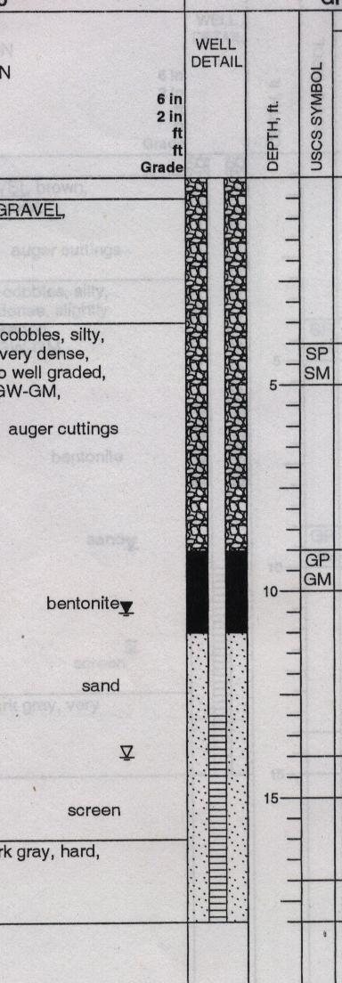
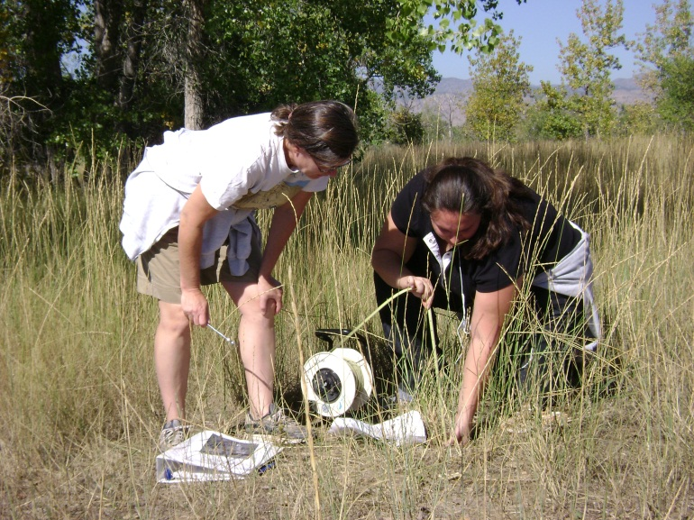
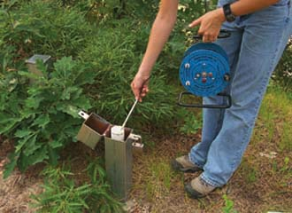
Depth to water table measured at a well
1350.62 m
Measure groundwater levels
Depth to water
7 m
Well depth
18 m
Water level =
(surface elevation) – (depth to water)
Notes:
Traditionally groundwater levels have been measuring the depth to the water table in wells.
Left image: Shemin Ge (CU Boulder)
Right image: USGS (https://pubs.usgs.gov/fs/fs07903/)

Slide 38
Relating changes in water table to changes in storage
In > out replenished, water table/level goes up
In < out depleted, water table/level decline
Note: Another term you will hear is “specific yield” which is the “drainable porosity” in an unconfined aquifer – meaning the actual amount of water that will leave an aquifer, somewhat less than the total water than may be present.
Notes:
Why divided by porosity?
The potential groundwater storage in a given area is related to the type of material the water is in – Clay? Silt? Sand?
Each has their own range of porosities or more appropriate for groundwater change, specific yield.
However, for the purposes of this unit, we will not get overly hung up on the difference.
Slide by Shemin Ge (CU Boulder)

Slide 39
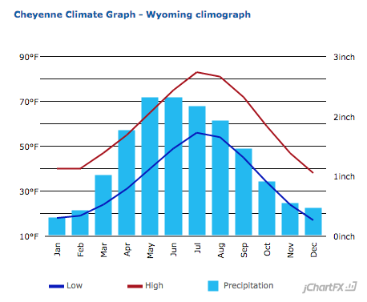
Understanding seasonal cycles in groundwater depths
Notes:
Student are challenged with understanding how irrigation withdrawal affects groundwater levels.
Use these graphs to help students walk through the concept that irrigation causes water lowering earlier in the year than we would expect if rainfall alone were the primary cause.
For instance, show them the precipitation graph and ask them to predict the month they would expect the highest groundwater levels. Then show them the well data and ask if this matches their prediction or not? (note: the well data are from Site 1 in the student exercise but they do not need to know this).
Next ask them what could be causing the well levels to drop so quickly in May-June when precipitation levels are still high.
Left image data from: primarily National Climatic Data Center from the NOAA (via http://www.usclimatedata.com/climate/wyoming/united-states/3220)
Right image data from: https://groundwaterwatch.usgs.gov/InactiveHPNSites.asp?S=410111104223102&ncd=hpn

Slide 40
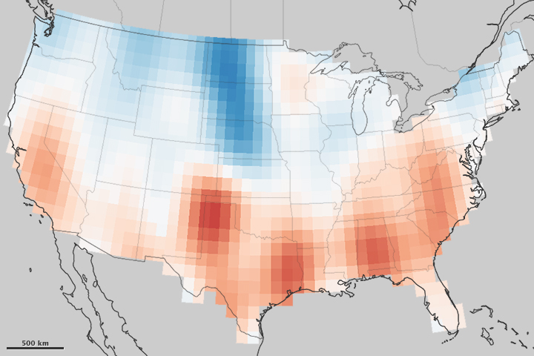

Example of GRACE Groundwater Data
Notes:
A decade of GRACE data shows the overall changes in aquifers across the USA. This image gives a sense of the cell size that limits GRACE resolution.
Image from: https://earthobservatory.nasa.gov/IOTD/view.php?id=82266
NASA site also includes a related article which instructors could use to bring in more aspects of specific societal challenges from groundwater loss.

Slide 41
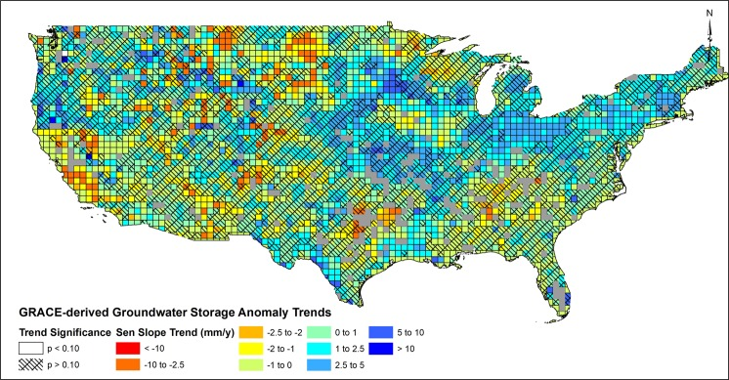
Using GRACE to measure trends in groundwater depletion
Thomas BF, Famiglietti JS. Identifying Climate-Induced Groundwater Depletion in GRACE Observations. Sci Rep. 2019 Mar 11;9(1):4124. doi: 10.1038/s41598-019-40155-y. PMID: 30858389; PMCID: PMC6411996.

Slide 42
Exercise: Analysis of gravity “mascon” time-series data
https://ccar.colorado.edu/grace/index.html
Notebook: https://github.com/jlmaurer/GE6146/blob/master/notebooks/Lab2_Gravity.ipynb

